Slide 1
Computer Organization & Architecture
Pushpendra Kumar Pateriya

Slide 2
Computer System
Hardware
Software

Slide 3
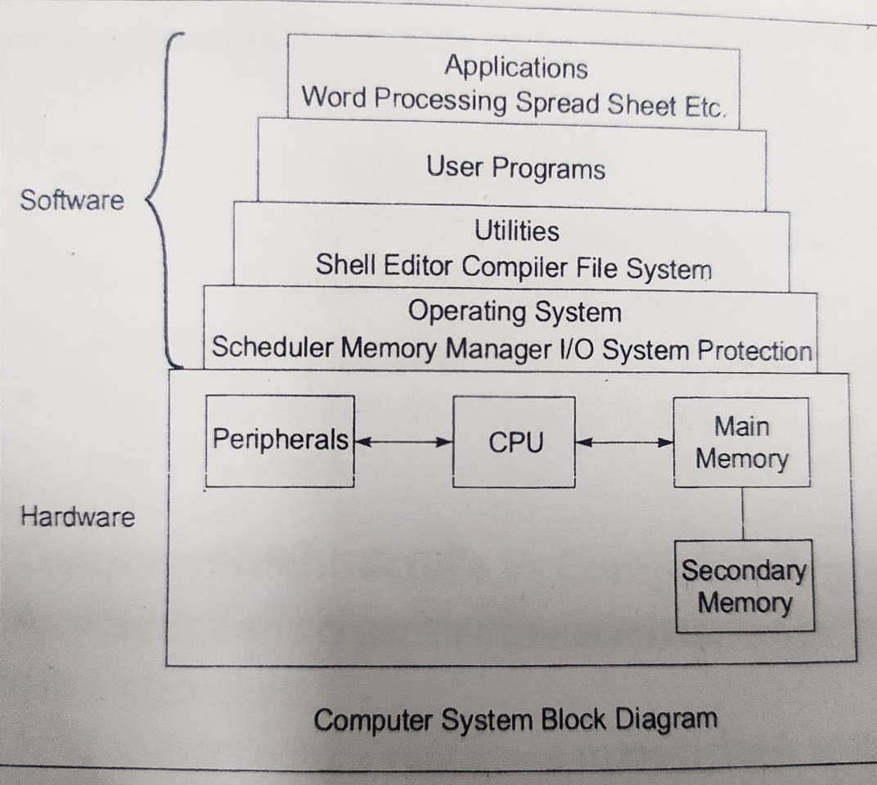
Computer System Block Diagram

Slide 4
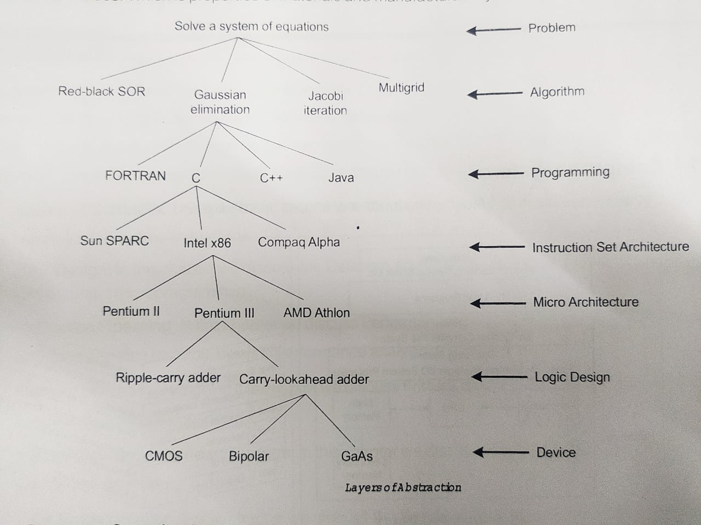
Layers of Abstraction

Slide 5
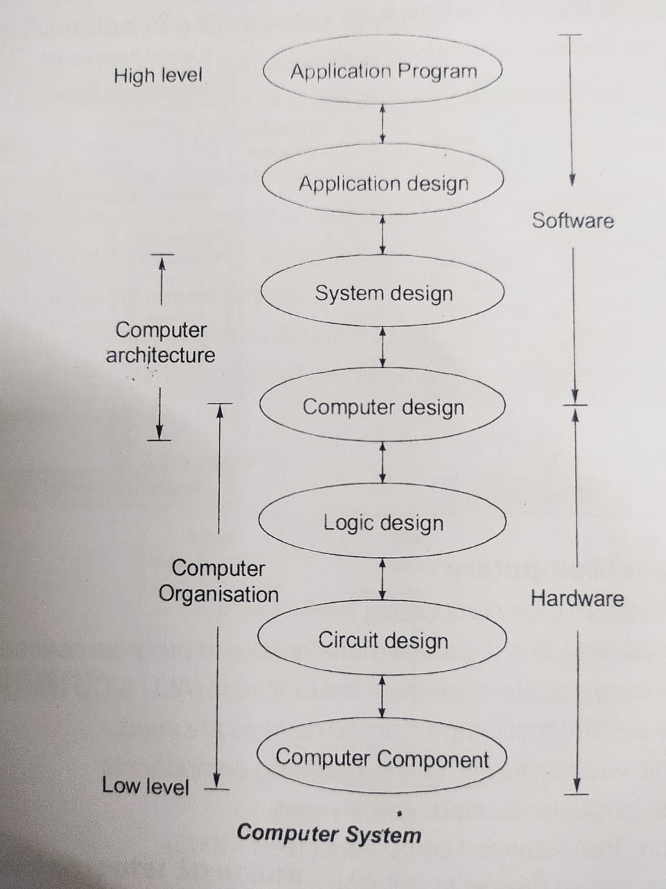

Slide 6
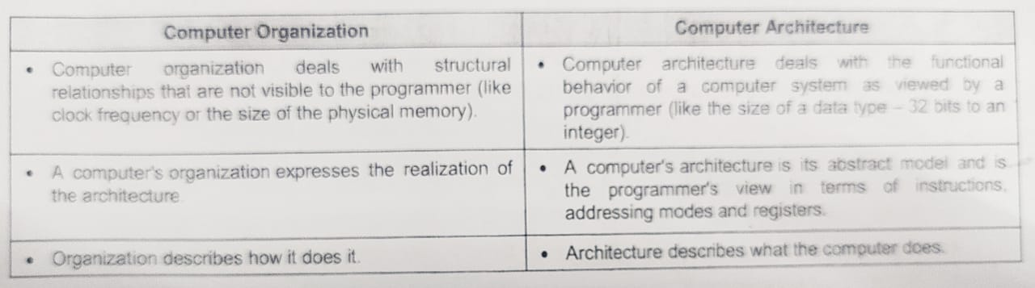

Slide 7
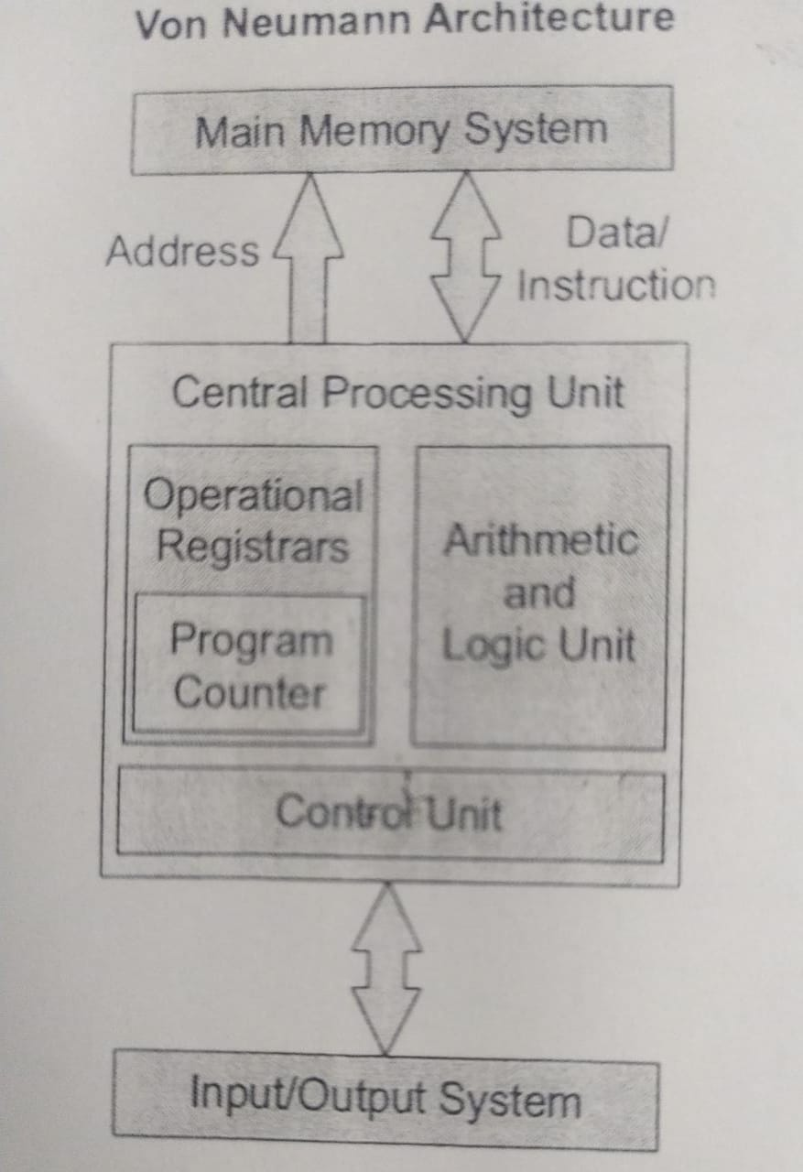
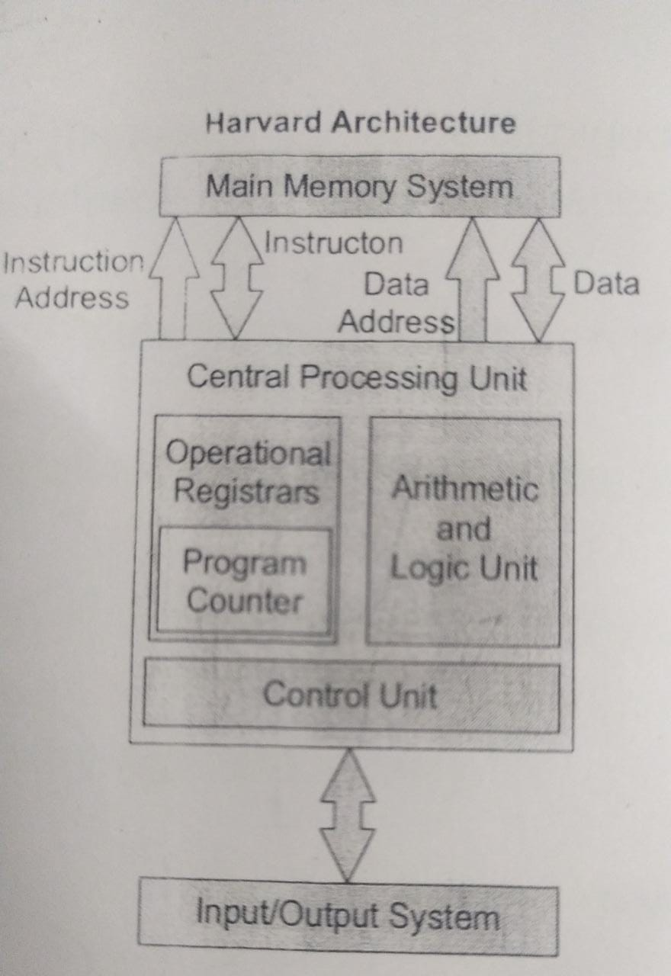

Slide 8
Evolution of Digital Computers
First Generation: Vacuum tube computers (1945 – 1953)
Program and data resides in same memory
Magnetic tapes used for storage
Assembly level language is used
Second Generation: Transistorized computers (1954 – 1965)
Transistor were used to design ALU & CU
High level language is used (FORTRAN)
To convert HLL to MLL/LLL compiler were used
Separate I/O processor were developed to operate in parallel with CPU (improved performance

Slide 9
Third Generation: Integrated circuit computers (1965 – 1980)
Multiprogramming, pipelining concepts were incorporated
DOS
Cache and virtual memory concepts were developed.
More than one circuit on a single silicon chip became available
Forth Generation: VLSI computers (1980 – 2000)
CPU termed as microprocessor
INTEL, MOTOROLA, TEXAX, NATIONAL semiconductors started developing microprocessor
Workstations, Microprocessor (PC) & Notebook computers were developed
Interconnection of different computers for better communication LAN, MAN, and WAN
Computational speed increased 1000 times
Specialized computers like Digital Signal Processor were also developed

Slide 10
Fifth Generation: System-on-chip (SOC) computers (2000 - )
E-commerce, E-banking, home office
ARM, AMD, INTEL, MOTOROLA
High speed processor – GHz speed
Because of submicron IC technology lot of added features in small size.

Slide 11
Components of Computer Structure
Input Unit:
Convert data from human language to machine language (input device)
Keyboard, mouse, Joystick, etc
Output Unit
Monitor, Printer, LCD, LED, etc
Memory Unit
Stores data and instructions required for processing
Stores the intermediate results obtain during processing
Stores final results before sending it to output unit

Slide 12
CPU
Major structural components of CPU
Control unit (CU): Controls the operations of the CPU and hence the computer
Arithmetic and Logic Unit (ALU): Performs computer’s data processing functions
Register: Provide storage internal to the CPU
CPU Interconnection: Communication among the control unit, ALU, and registers

Slide 13
Bus Structure
Bus: it is a group of wires which carries information from CPU to peripherals or peripherals to CPU.
The CPU and Memory are connected by Data Bus, Address Bus, and Control Bus
Address Bus:
Unidirectional
Carries address information bits from processor to peripherals
Data Bus
Bidirectional bus
Carries data information bit from processor to peripherals and vice-versa
Control Bus
Bidirectional bus
Carries control signals from processor to peripherals and vice-versa

Slide 14
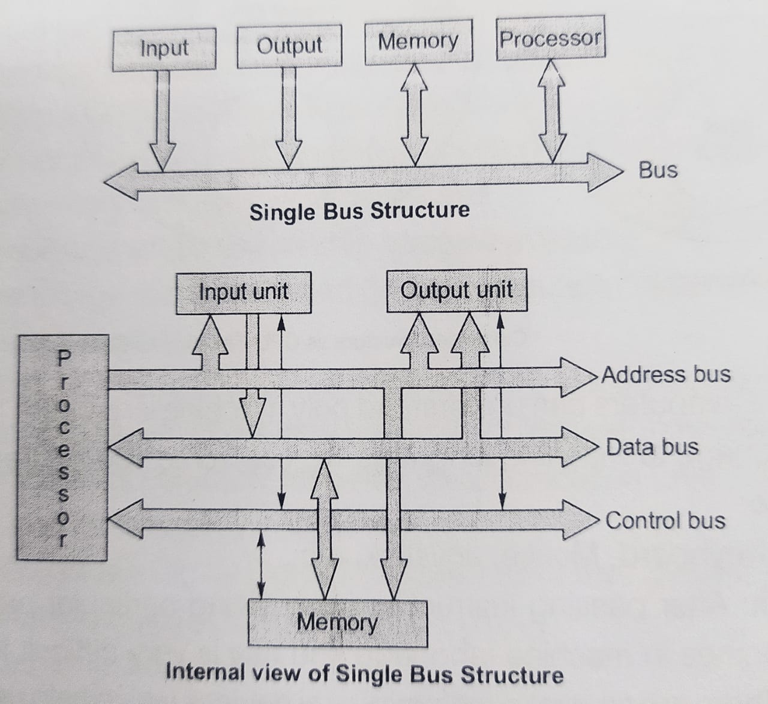

Slide 15
CISC and RISC Architectures
CISC | RISC
Large instruction set | Compact instruction set
Instruction formats are of different lengths | Instruction formats are of same lengths
Instructions perform both elementary and complex operations | Instructions perform elementary
Control unit is micro programmed | Control unit is simple and hardwired
Not pipelined or less pipelined | Pipelined
Single register set | Multiple register set
Numerous memory addressing options for operands | Less addressing modes
Include multi-clock complex instructions | Single clock, reduced instruction only
Memory-to-Memory: LOAD and STORE incorporated in instructions | Register-to-Register: LOAD and STORE independent instructions
Small code size, high cycles per second | Large code size, low cycles per second
Examples: VAX, PDP?11, Motorola 68000 family, Intel x86 architecture based processors | Examples: Apple iPods, Apple iPhone, ARM7, ARM based chip

Slide 16
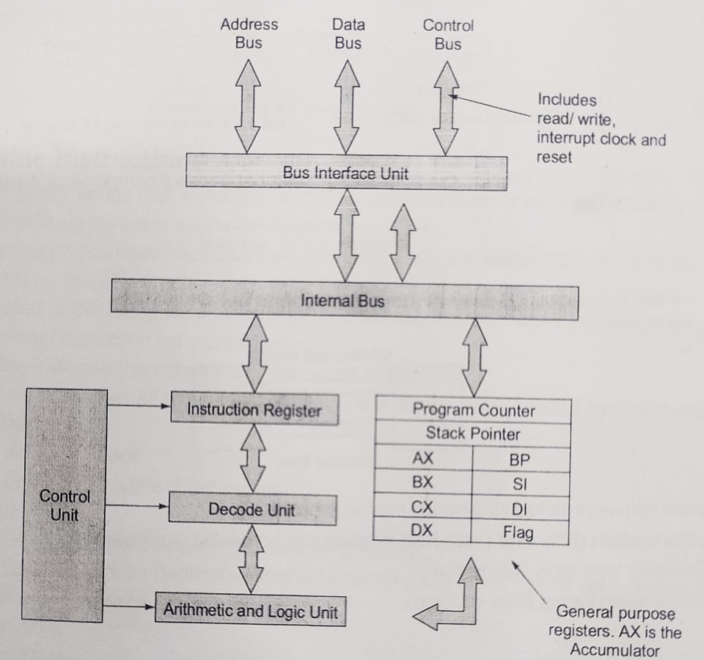
General CPU Architecture (8086 Microprocessor)

Slide 17
Issues of Computer Design
Speed and memory
Speed match between memory and processor
Handle bugs and errors
Shared memory
Disk access
Better performance with reduced power

Slide 18
Data Storage in Memory
Little Endian (Little end first)
Big Endian (big end first)

Slide 19
Machine Instructions
A set of binary codes that are recognized and executed directly by a processor is called a machine code. An individual machine code is called a machine instruction.
Main memory holds instructions and Data.
Each instruction/data require one or more memory locations depends on size of instruction/data
The set of all codes recognized by a particular processor is known as instruction set.

Slide 20
Memory Models (how does the memory look to the CPU)
Addressable cell size
Alignment
Address space
Endianness (Little/Big)

Slide 21
Registers
General Purpose
Special Purpose: Program Counter (PC), Stack Pointer (SP), Input/Output Registers, Status Register

Slide 22
Data Types

Slide 23
Instructions

Slide 24
Encoding Machine instructions
Machine Instructions are encoded in a binary pattern that specifies
Operation
Operation/addresses used for the operation
Where the result should be placed if any

Slide 25
Fields of an instruction
OPCODE
Operand/Address Field
Mode

Slide 26
Instruction formats
Three address instruction
Two address instruction
One address instruction
Zero address instruction

Slide 27
Tree Address Instructions
OPCODE
Address
Address
Address
ADD | A | 200 | 100
000001 | 1100 | 000…00011001000 | 000…0001100100
Example: ADD A, [200], [100]

Slide 28
Disadvantages
Long instruction length
May be three memory accesses needed for an instruction

Slide 29
Write the tree address instructions for the following statement
X = (A + B) X (C + D)
Solution:
ADD R1, A, B R1 ← M[A] + M[B]
ADD R2, C, D R2 ← M[C] + M[D]
MUL X, R1, R2 M[X] ← R1 x R2

Slide 30
Two Address Instruction
OPCODE
Address
Address
One OPCODE and Two Address Fields
Example: ADD A, [100]

Slide 31
Disadvantages
It may needs three memory accesses, eg: ADD [200] [100]

Slide 32
Write the two address instructions for the following statement
X = (A + B) X (C + D)
Solution:
MOV R1, A R1 ← M[A]
ADD R1, B R1 ← R1 + M[B]
MOV R2, C R2 ← M[C]
ADD R2, D R2 ← R2 + M[D]
MUL R1, R2 R1 ← R1 X R2
MOV X, R1 M[X] ← R1

Slide 33
One address instructions
OPCODE
Address
Example: ADD [100]

Slide 34
Advantages
Shorter instruction
Eliminates two memory accesses
Faster accessing location inside processor than memory

Slide 35
Disadvantages
Only one location for one operand and result
Still it may need one memory access

Slide 36
Write the one address instructions for the following
X = (A + B) X (C + D)
Solution:
LOAD A; AC ← M[A]
PUSH A; TOS ← A
PUSH B; TOS ← B
ADD ; TOS ← (A + B)
PUSH C; TOS ← C
PUSH D; TOS ← D
ADD ; TOS ← (C + D)
MUL ; TOS ← (C+D) x (A+B)
POP X; M[X] ← TOS

Slide 37
Zero Address Instruction
OPCODE
Example: Add ;
it adds top two elements of the stack and stores result at top of stack

Slide 38
Write the zero address instructions for the following statement:
X = (A + B) X (C + D)
Solution:
LOAD A; AC ← M[A]
PUSH A; TOS ← A
PUSH B; TOS ← B
ADD ; TOS ← (A + B)
PUSH C; TOS ← C
PUSH D; TOS ← D
ADD ; TOS ← (C + D)
MUL ; TOS ← (C+D) x (A+B)
POP X; M[X] ← TOS

Slide 39
Addressing modes

Slide 40
Types of Addressing Modes
Implied Mode
Immediate Mode
Register Mode
Register Indirect
Direct (Absolute) Address Mode
Indirect Address Mode
Indexed Addressing Mode
Base with Index Address Mode
Relative Address Mode
Auto Increment and Auto Decrement Modes

Slide 41
Implied Mode
The actual specified implicitly in the definition of the instruction
Example: Zero-address instruction (stack operations ADD and SUB)

Slide 42
Immediate Mode
The actual operand (data) is specified in the instruction
Example: MOV R1, 123
The operand 123 is held in the instruction
Example (High Level): x = 123

Slide 43
Register Mode
The instruction specifies a register that has operand
Example (Assembly): MOV R1, R2
Instruction has register R1 and R2 operand
Example (High Level): x = y

Slide 44
Register Indirect Mode
The instruction specifies a register that contains the address of the operand
The operand is held in memory. The address of the operand location is held in a register which is specified in instruction.
Example (Assembly): ADD R1, (R2)
Instruction has register R2 and R2 has memory address of operand.
Example (High Level): int *x;

Slide 45
Direct (Absolute) Address Mode
Example: MOV R1, [1000]
The operand is in memory and the memory address 1000 of the operand is held in instruction.

Slide 46
Indirect Address Mode
Example (Assembly): ADD R1, (1000)
Instruction has memory address 1000. At location 1000, the memory address of operand is available.
Example (high Level):
int *x;
int y, z=0;
x = &y;
*x = 123;
z = z + *x; // z is similar to R1, x is similar to 1000.

Slide 47
Indexed Addressing Mode
The effective address is the sum of an index register and the offset field (constant). It is similar to register indirect addressing except an offset held in the instruction is added to register contents to compute the effective address. The indexed addressing mode is useful in dealing with lists and arrays.
Example: MOV R1, 2(R2);
R1 stores operand from memory address: 2 + (R2)
R2 has memory address and offset is 2.
By adding 2 and content of R2 gives the effective address of operand
Example (High Level): int x[10], y; y= x[2];

Slide 48
Base with Index Address Mode
The effective address is the sum of contents of based register and index register.
Example(Assembly): MOV R1, (R2, R3)
Register R2 contain the base address and R3 contain the index.
The effective address is the sum of the contents of registers R2 and R3.
Example (High Level): int x[10], i=2, y; y=x[i]; //where y, x, and I are similar to R1, R2, and R3 respectively.

Slide 49
Base with Index and offset Mode
It uses two registers Ri and Rj plus a constant X. The effective address is the sum of the constant X and the contents of registers Ri and Rj.
Example(Assembly): MOV R1, 2(R2, R3)
Register R2 contains the base address and R3 contain the index. The effective address is the sum of the constant value 2, the contents of register R2 and R3.
Example(High Level): int x[10], i=2, y; y=z[i+3]; // where y, x, and I are similar to R1, R2, and R3 respectively

Slide 50
Relative Address Mode
The effective address is the sum of the address field (offset) and the content of the program counter (PC). Specify target location as number of instructions from branch/jump instruction.
Makes code relocatable (i.e. code can be loaded anywhere in memory without altering branch/jump instructions).
The number of locations to the target is held in the instruction as an offset.
Example: Assume PC holding 100 while executing the following instruction. JUMP 123; control will transfer to 110 by adding 100 with offset 23. In high level (C) programming, using goto relative addressing can be done.

Slide 51
Auto increment and auto decrement modes
Post Auto increment mode:
The effective address of the operand is the contents of a register specified in the instruction. After accessing the operand, the contents of this register are automatically incremented to point to the next item in a list. It is denoted as (R_{i})+
Example: MOV R1, (R2)+
Pre Auto Increment Mode:
Before accessing the operand, the contents of this register are automatically incremented to point to the next item in a list. Then effective address of the operand is the incremented contents of a register. It is denoted as +(R_{i})
Example: MOV R1, +(R2)

Slide 52
Post Auto Decrement mode:
The effective address of the operand is the contents of a register specified in the instruction. After accessing the operand, the contents of this register are automatically decremented to point to the next item in a list. It is denoted as (R_{i})⁻
Example: MOV R1, (R2)-
Pre Auto Decrement Mode:
Before accessing the operand, the contents of this register are automatically decremented to point to the next item in a list. Then effective address of the operand is the decremented contents of a register. It is denoted as -(R_{i})
Example: MOV R1, -(R2)

Slide 53
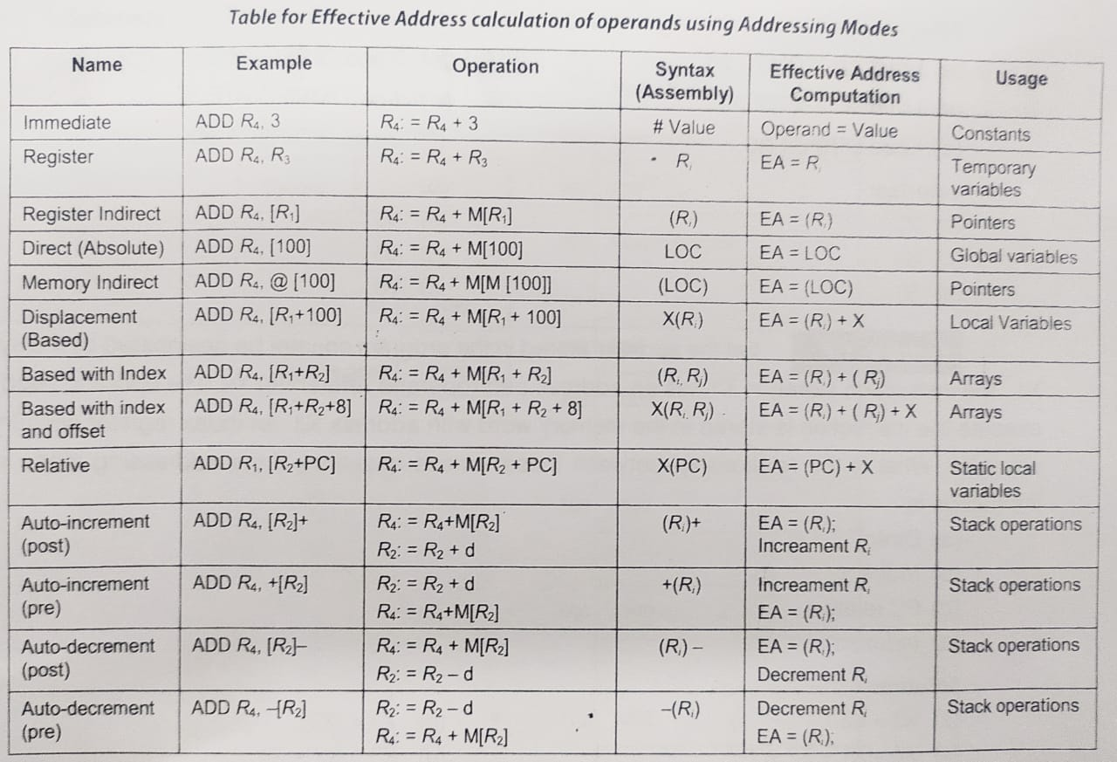

Slide 54
Question
An address field in an instruction contains decimal value 14. Where is the corresponding operand located for:
Immediate addressing?
Direct addressing?
Indirect addressing?
Register addressing?
Register indirect addressing?

Slide 55
Solution
14 (the address field)
Memory location 14
The memory location whose address is in memory location 14
Register 14
The memory location whose address is in register 14

Slide 56
Question
Given the following memory values and a one address machine with an accumulator:
Word 20 contains 40
Word 30 contains 50
Word 40 contains 60
Word 50 contains 70
What values do the following instructions load into the accumulator?
Load IMMEDIATE 20
Load DIRECT 20
Load INDIRECT 20
Load IMMEDIATE 30
Load DIRECT 30
Load INDIRECT 30

Slide 57
Solution:
20
40
60
30
50
70

